Slide 1
Overview
Name :- Devansh B. Vala
Standard :- FYIT(sem-2)
Roll no. :- 97

Slide 2
Green IT Adoption Trends: An Overview
This report divides 11 Green IT initiatives into four major groups:
Virtualization and Consolidation
Energy Efficiency
Travel Reduction
Asset Disposal.

Slide 3
Four major groups:
Virtualization & Consolidation:
Initiatives in this area include server virtualization and consolidation, storage consolidation and desktop virtualization. These projects typically improve cost and energy efficiency through optimized use of existing and new computing and storage capacity, electricity, cooling, ventilation and real estate.
Energy Efficiency:
Initiatives in this area include server room upgrades and new builds, IT energy measurement, printer consolidation, and PC power management. These projects have energy efficiency or reduction as a major cost savings benefits.
Travel Reduction:
Initiatives in this area include remote conferencing & collaboration and telecommuting. These projects are typically associated with reductions in travel, fuel and commuting costs.
Asset Disposal:
IT equipment recycling is the lone initiative in this category.

Slide 4
Half the companies who participated in this study are either piloting or implementing at least one of the 11 Green IT initiatives.
By and large, the most commonly adopted initiatives involve major cost savings up-front, with fewer major investments required.
The most popular initiatives across the board include storage consolidation, remote conferencing and telecommuting, all of which yield immediate cost reduction benefits to the business if implemented correctly

Slide 5
Study and methodology
Name :- Paras Poriya
Standard :- FYIT(Sem-2)
Roll No. :- 64

Slide 6
Energy Efficiency
Name :- Roshan Maurya
Standard :- FYIT(Sem-2)
Roll No. :- 40

Slide 7
Energy Efficiency
Green Computing is a recent trend towards designing, building, and operating computer systems to be energy efficient.
The goals are to maximize energy efficiency during the product's lifetime, reduce the use of hazardous materials
It Promote recyclability or biodegradability of defunct products and factory waste

Slide 8
Advantages
The many benefits of energy efficiency include: Environmental:
Increased efficiency can lower greenhouse gas (GHG) emissions and other pollutants, as well as decrease water use.

Slide 9
Disadvantage
For large firms, many efficiency investments are too small to be attractive because of high transaction costs of the cost of energy-efficient equipment.
The conventional method used to conserve genetic resources of date palm has been supplemented in recent years by rapid developments in plant biotechnology.

Slide 10
The following are examples of energy efficiency.
Reuse
Resource Utilization
Efficient Design
Maintenance
Waste Reduction

Slide 11
Laws of nature
Name :- Abhay Gupta
Standard :- FYIT(Sem-2)
Roll No. :- 15

Slide 12
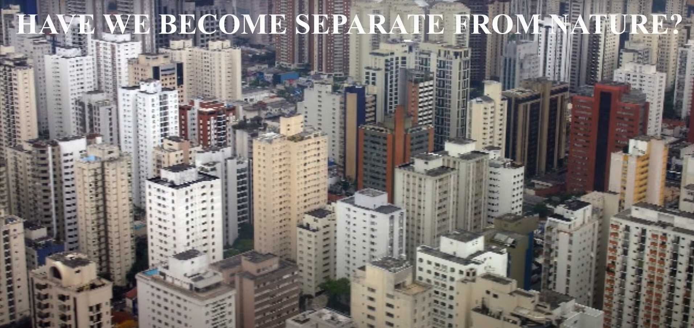

Slide 13
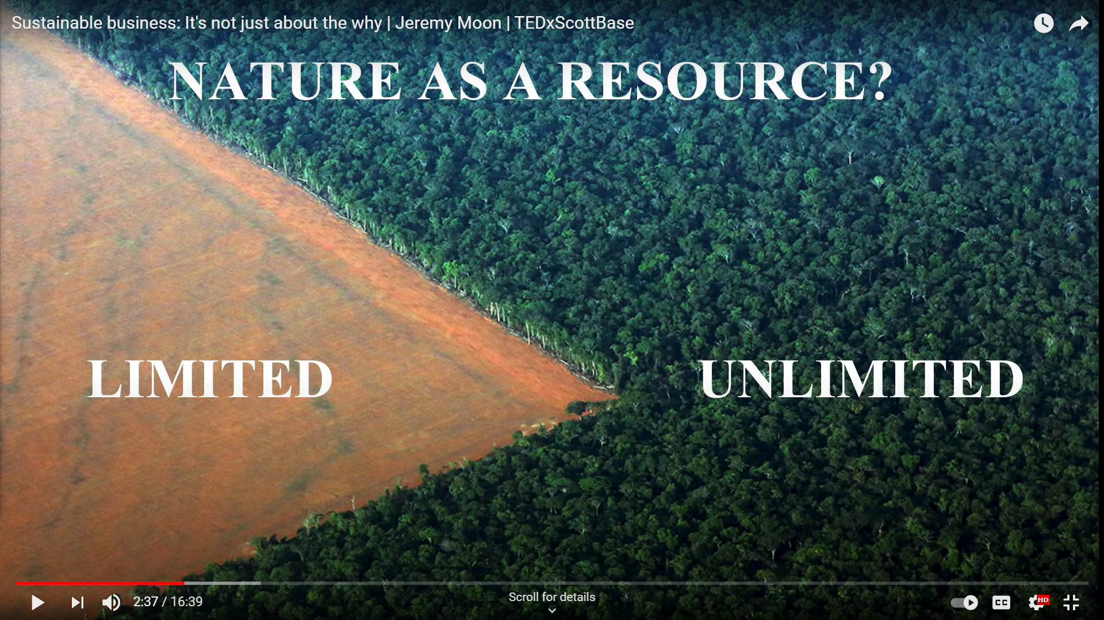

Slide 14
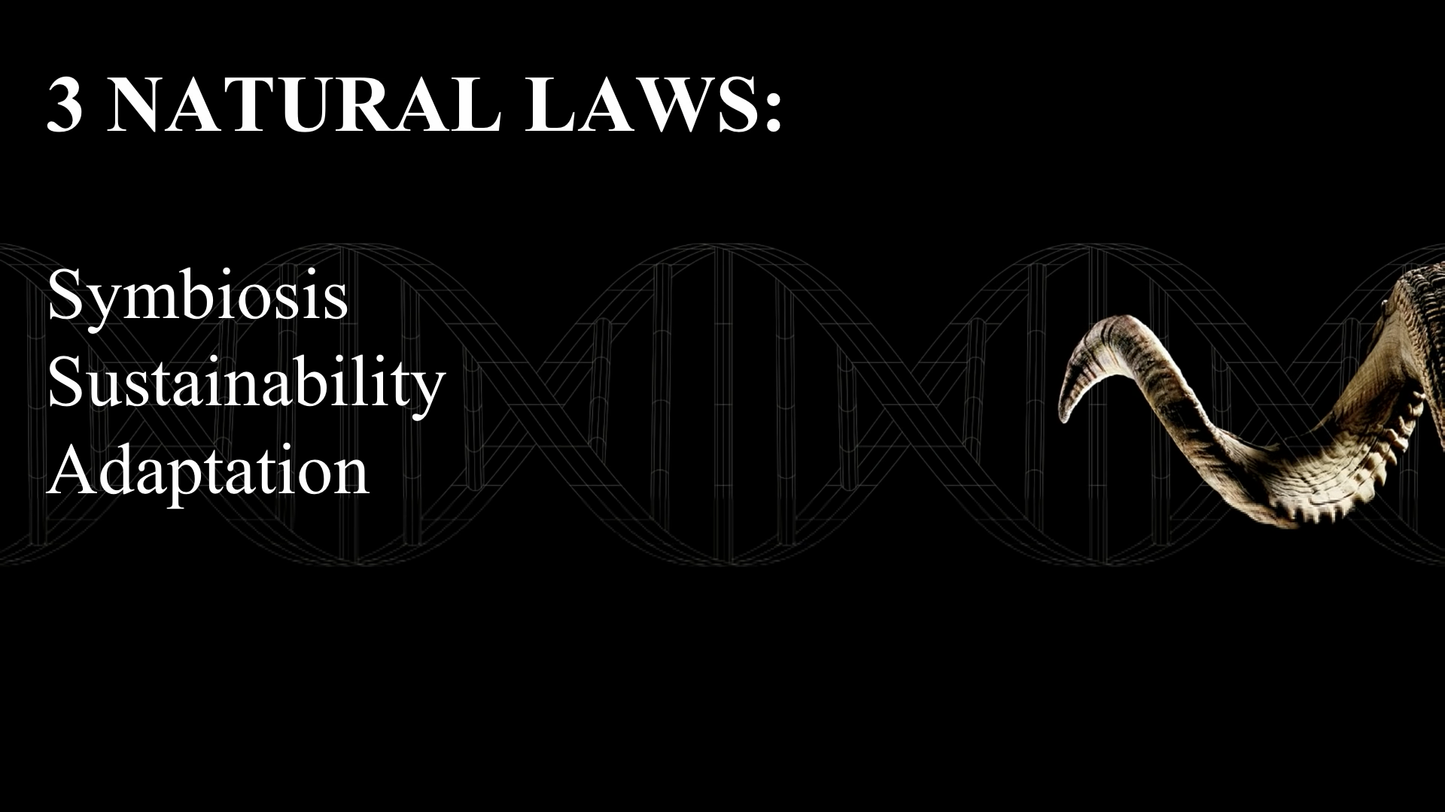

Slide 15
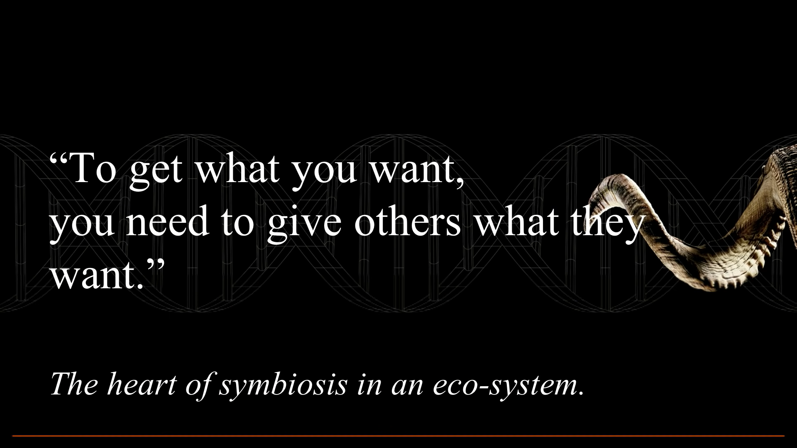

Slide 16


Slide 17
TRAVEL REDUCTION
Name :- Nitesh Vasave
Standard :- FYIT(Sem-2)
Roll No. :- 143

Slide 18
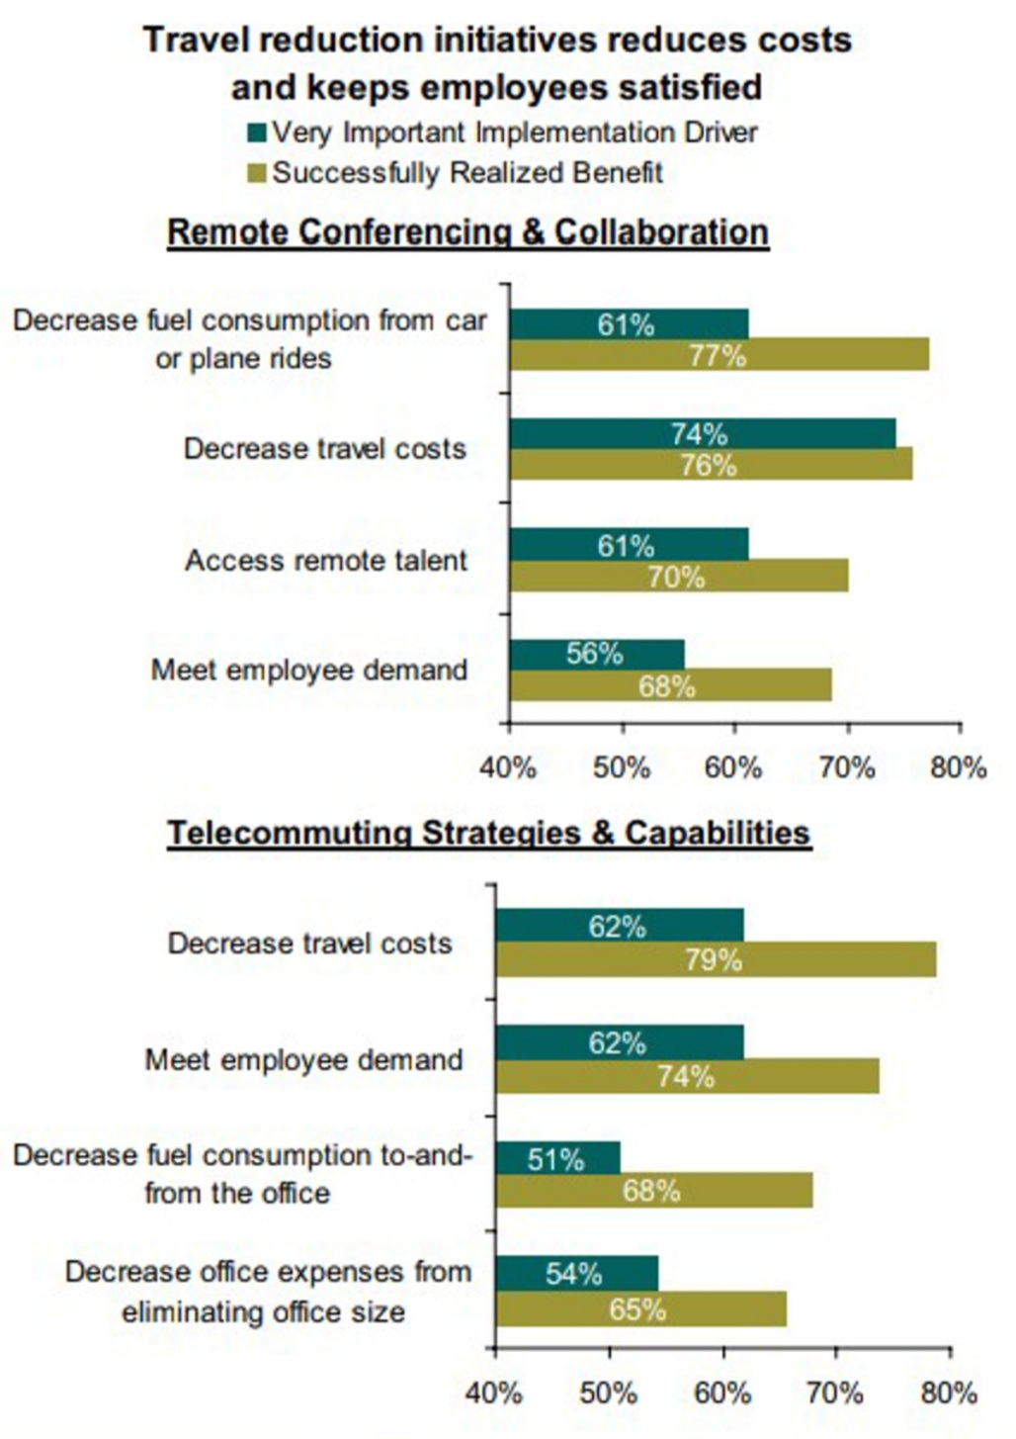
TRAVEL REDUCTION
(Nitesh vasave Roll no:- 143)
Remote configuration & Telecommuting Strategies
Remote configuration and collaboration:-
Telecommuting Strategy and Capabilities:-
Policies and strategies allowing or encouraging employees to
Work from home.

Slide 19
CUTTING TRAVEL COSTS WHERE IT COUNTS
These initiatives not only reduce costs of fuel,flights,hotels and related expenses,but also result in higher employee satisfaction.
Keeping Your People Happy
Organization are also gaining access to remote talent that they otherwise would not be able to tap. In two-thirds of all travel reduction projectOrganization reports their employees are very satisfied with the increased flexibility they are now offered.

Slide 20
Green Supply Chain Management Initiatives
Name :- Aman Yadav Standard :- FYIT(Sem-2) Roll No. :- 103

Slide 21

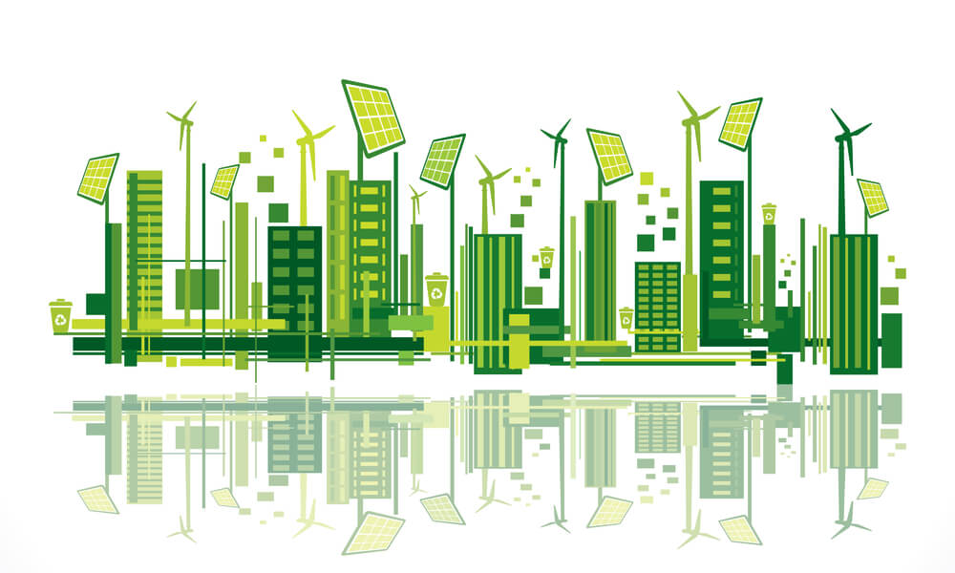
Green Supply Chain Management Initiatives
Green Supply Chain Management aims to integrate environmental thinking into supply chain management.
This includes product design,material sourcing and selection, the manufacturing process and delivery of the final product to consumers.
Approximately 2 million tons of e-waste are generated annually in india
The management of e-waste and implementation of green initiatives to manage the supply chains have become imperative for Indian IT and electronics industry.
They are innovating and coming up with cutting edge solutions that help them become more profitable, while helping the environment

Slide 22

HCL Infosystems Limited
HCL Infosystems Ltd. is India´s premier hardware, services and ICT systems integration company, which offers a wide spectrum of ICT products that include computing, storage, networking, security, telecommunication, imaging and retail solutions
HCL always focused on developing a sustainable future through environment friendly ICT products and services.
This led to the introduction of Green desktops, equipped with the unique Dynamic Energy Saver (DES) technology, that cut overall power consumption by 20-35%.
The company has also taken the following initiatives to conserve energy:
• Use of recyclable packing materials in PCs and monitors.
• Made S3 as the default sleep state in all products shipped with Microsoft Windows OS, so that the product automatically switches to standby mode after a specified amount of system inactivity.
• Compliance with MPR-II certification for CRT monitors.
• Compliance with TCO’03 certification for LCD monitors.

Slide 23

Tata Consultancy Services
Tata Consultancy Services (TCS) Limited is one of the best Indian IT services, consulting and business solutions organizations.
It is committed to measure, report and continually improve its overall environmental performance by optimizing its resource consumption, minimizing its ecological impact and in line with the precautionary principle espoused by Article 15 of the Rio Declaration, working to reduce its carbon footprint.
TCS has developed an environment policy that guides its key activities. The basic foundation of the policy is:
Climate change mitigation through commitment to reduce Greenhouse Gas (GHG) emissions and corresponding carbon footprint.
Green procurement.
Reduce, reuse, recycle.
Resource efficiency.
Green infrastructure – green buildings.
Green IT.

Slide 24
IT EQUIPMENT RECYCLING ♻️
Name: Aryan Pandey
Roll number: 114
Class : fyit

Slide 25
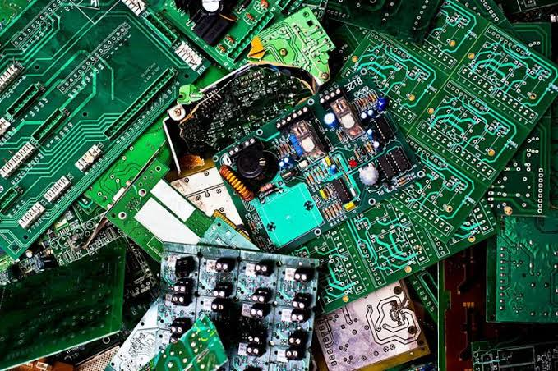
IMPORTANCE ElECTRONIC RECYCLING
• Rich source of raw materials
• Solid waste management
• Toxic materials
• International movement of hazardous waste

Slide 26
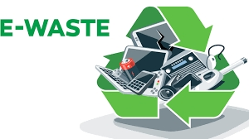
E-waste
E waste in electrical electronic equipment that has been discarded working and broken items that are thrown in in the garbage aur donated to the charity reseller like goodwill.
E-waste is particularly dangerous due to toxic chemical that naturally from the metals inside when buried.

Slide 27
Disadvantages of going green
Name :- Bhushan Kadam Standard :- FYIT(Sem-2) Roll No. :- 32

Slide 28
Disadvantages of going green
Expenses :
Data Safety is important :
Dearness
Customer backlash

Slide 29
Disadvantages of going green
5. Is it worth it?
6.Competition
7. Marginal impact

Slide 30
Green It emissions and Green It typical dimensions
Name :- Ritesh soni Standard :- FYIT(Sem-2) Roll No. :- 90

Slide 31
Green It
Virtualization And Consolidation
Energy Efficiency

Slide 32
Asset Disposal
Factors During Implementation
Green It Outcomes

Slide 33

Name: Rahul Kushwaha
Class: FYIT Roll No: 37
Topic: Green IT Companies and Vendors
GREEN COMPANIES WITH AMAZING ENVIRONMENTAL INITIATIVES

Slide 34
1.DISNEY
AS FAR AS SUSTAINABLE COMPANIES GO, DISNEY IS A GIANT. IT USES ZERO NET DIRECT GREENHOUSE GAS EMISSION POLICIES IN ALL OF ITS FACILITIES. IT’S ALSO TRYING TO REDUCE ELECTRICAL AND WATER CONSUMPTION, WHICH WILL REDUCE INDIRECT GREENHOUSE GAS EMISSIONS. TECHNOLOGY HELPS DISNEY SAVE WATER AND LOWER ITS MANUFACTURING AND DISTRIBUTION FOOTPRINT AS WELL.
OVERALL, DISNEY IS A LEADER IN ENVIRONMENTAL RESPONSIBILITY FOR POLICIES SUCH AS:
ZERO WASTE (NOTHING IN LANDFILLS)
NET POSITIVE ENVIRONMENTAL IMPACT

Slide 35
2.DELL
DELL FIRST STARTED ITS LEGACY OF GOOD PLAN IN 2013 TO USE TECHNOLOGY TO DRIVE HUMAN PROGRESS AND ADVANCE HEALTH, HAPPINESS AND PROSPERITY. IN 2020 , DELL’S NEW LEGACY OF GOOD PLAN IS LOOKING AT THE COMPANY’S LONG-TERM COMMITMENT TO SOCIETY, ITS TEAM MEMBERS AND THE ENVIRONMENT.
THE BUSINESS HAS ALREADY ACHIEVED ITS GOAL OF USING 50 MILLION POUNDS OF SUSTAINABLE MATERIALS IN ITS PRODUCTS. THEY HOPE TO INCREASE THAT NUMBER TO 100 MILLION POUNDS IN THE FUTURE.
DELL ALSO ANNOUNCED IT WOULD INCREASE THE ANNUAL USAGE OF OCEAN BOUND PLASTICS
BY 10 TIMES BY 2025. THIS INITIATIVE WOULD KEEP 16,000 POUNDS OF PLASTIC FROM ENTERING THE OCEAN.

Slide 36
3.APPLE
WHEN CONSIDERING ENVIRONMENTALLY CONSCIOUS COMPANIES, MANY DON’T LOOK AT BIG TECH BUSINESSES SUCH AS APPLE. HOWEVER, THE COMPANY FOCUSES ON THREE MAIN AREAS — REDUCING ITS IMPACT ON CLIMATE CHANGE, PRESERVING PRECIOUS RESOURCES AND USING SAFER MATERIALS IN PRODUCTS
AND PROCESSES.
SINCE SETTING THOSE GOALS, APPLE HAS
CREATED SEVERAL WIND AND SOLAR
FARMS TO POWER THEIR DATA CENTERS, RETAIL STORES, CORPORATE OFFICES AND MORE. THE CORPORATION IS ATTEMPTING TO PRESERVE MATERIALS BY INCREASING PRODUCTION EFFICIENCY, USING RENEWABLE RESOURCES AND DESIGNING LONG-LASTING PRODUCTS. APPLE HAS ALSO MADE STRIDES IN IMPROVING ITS ENVIRONMENTAL TESTING LAB TO ENSURE PRODUCTS ARE SAFE.

Slide 37
Thanks for Watching

